Slide 1
DBMS Final project
Lim Ze Dong - 2023280123
Namie Turi Abu - 2023280116

Slide 2
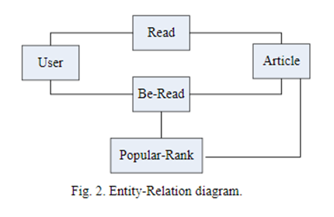
Project Requirements
Derive a partitioning and replication strategy based on the user access patterns, nature of the data, and location.
Automated DBMS server status monitoring.
Create Be-Read & Popular Rank table
Query top 5 daily, weekly and monthly popular articles.
Notes:
We need to derive a partitioning and replication strategy based on the user access patterns, nature of the data, and location (Beijing/Hongkong).
• Identify a distributed database management system that fulfills the requirements (autonomously fragmenting the data based on the amount and the location, the workload: enabling for insert, updating and read queries in an efficient manner).
• Automated DDMS server status monitoring
• Create a be-read and popular rank table - by inserting newly computed records into the Be-Read table.
• Speak about the schema - We create 2 schemas named as DBMS1 and DBMS2 to store the fragmented data

Slide 3

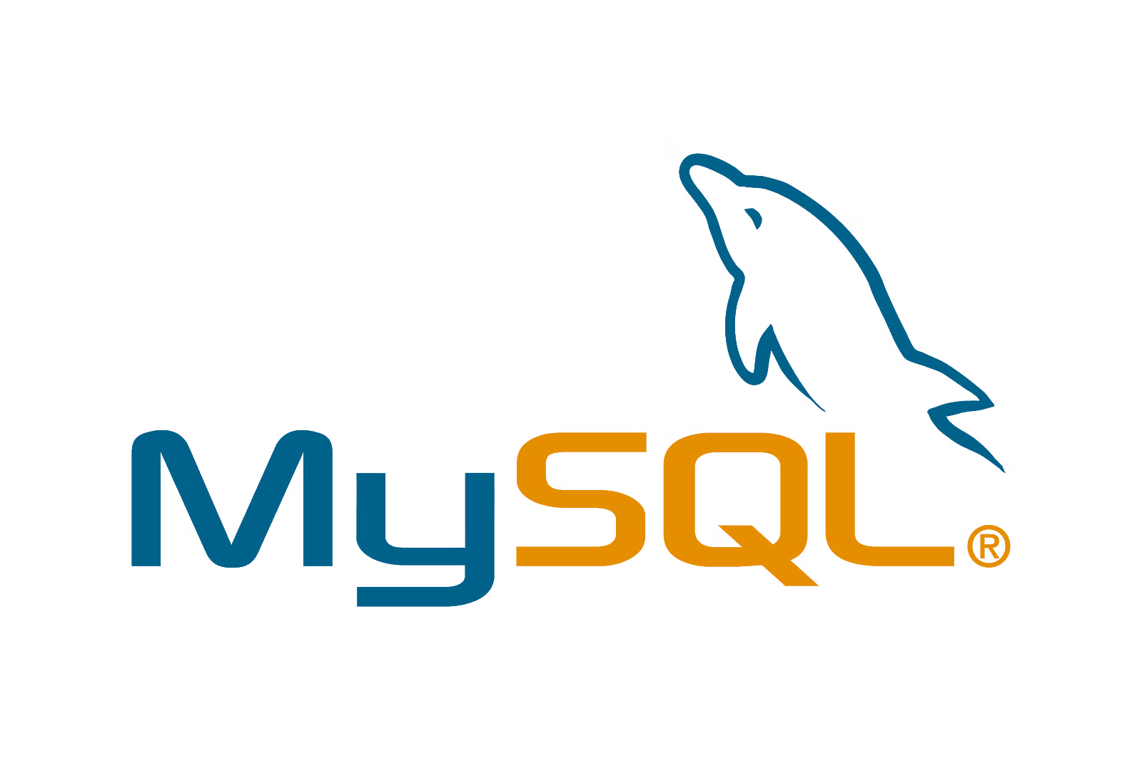
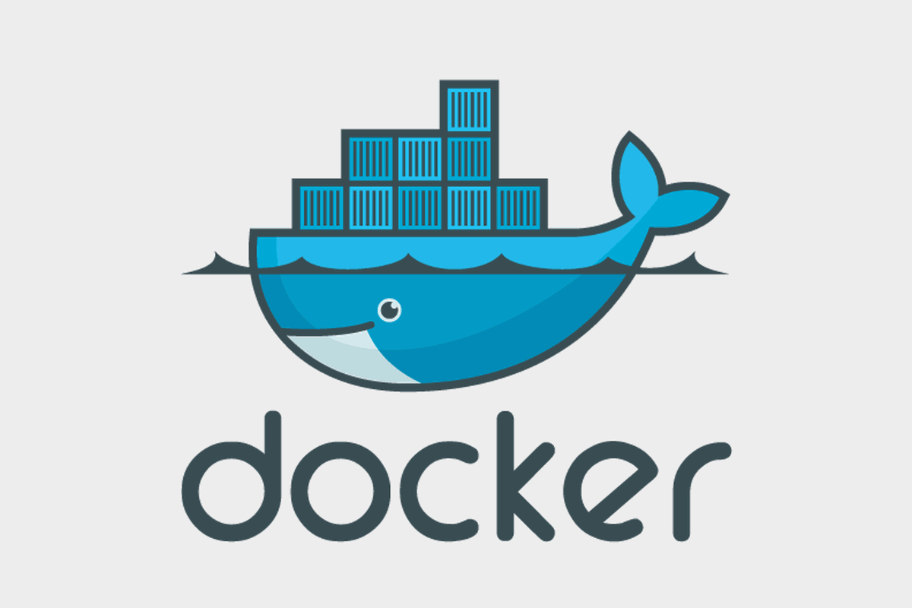
Approach
MINIO
File storing system
Replication
Monitoring
MySQL Workbench
Database
Fragmentation
Monitoring
Cache
Docker
Flask
Implement query
Fetch data from MINIO
Notes:
Default cache by mysql workbench
Explain Hadoop failure. So we find alternative which is minio. Briefly introduce about minio.
We encountered errors on setting up hadoop on dockers so, we decided to use minio which is relatively easier to use.
Minio is an open-source, scalable object storage server and cloud platform that supports various operating systems including Windows, Linux, and macOS. Its compatibility and flexibility make it easy to deploy for a range of applications, serving as a versatile solution for scenarios like data archiving, backup and restore, analytics, and as a backend for applications that require scalable and distributed object storage.

Slide 4
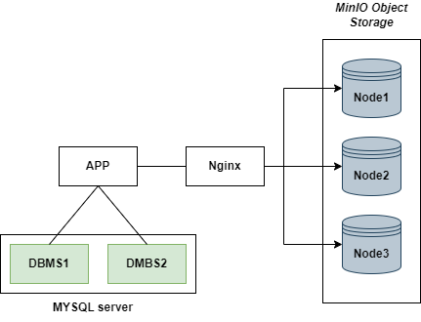
Approach

Slide 5
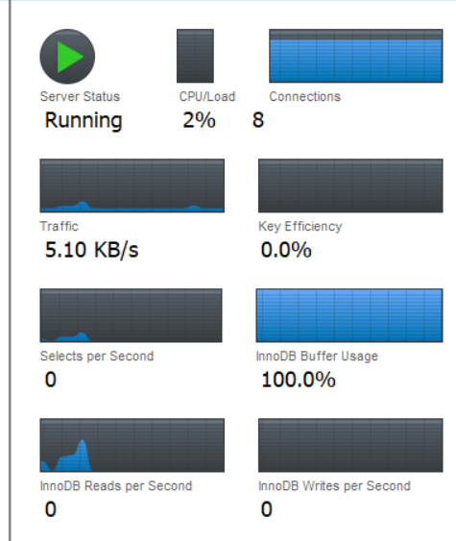
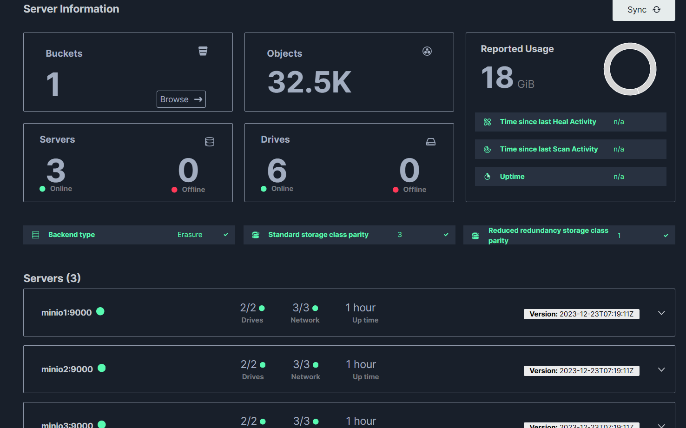
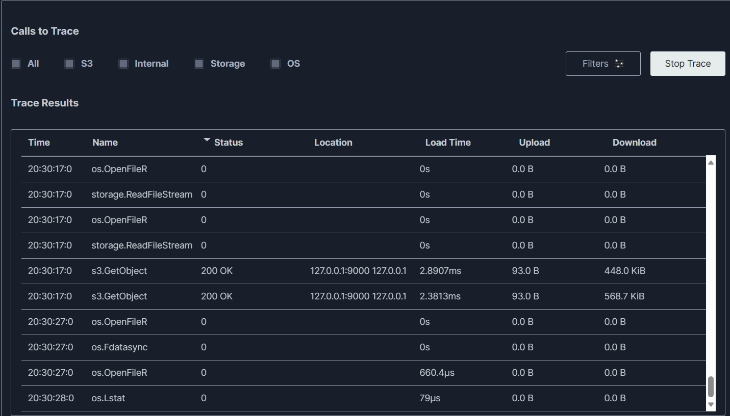
Monitoring
Notes:
The database monitoring and minio

Slide 6
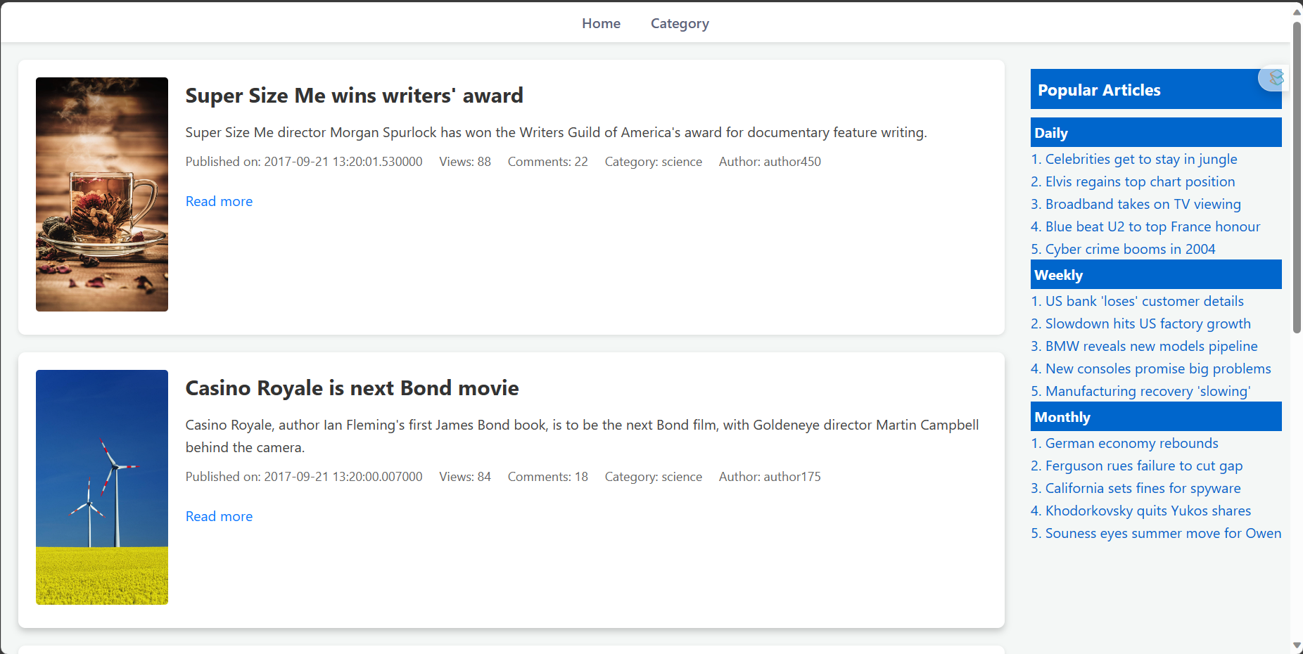
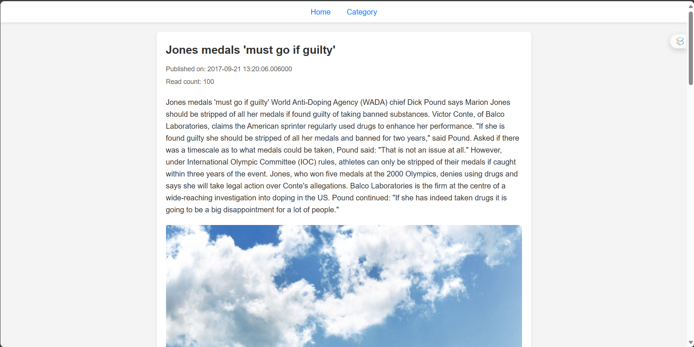
DEMO
Notes:
Article 13 has video

